Slide 1
Agile & Risk Based Testing

Slide 2
Risk based test automation in an Agile environment.
..
Ben Visser & Peter Nwankwo
Amsterdam, June, 2017
Notes:
Ever discussed risk based test automation with Agile developers, CICD pipeline architects and the like?
They often paint a situation in which everything is tested through automation and if that takes too long, they would just ‘spin up some extra virtual machines’. Recognizable?
I won’t go into the feasibility of that vision. Actually, I’d like to believe we’ll reach a point somewhere in the future where it is true, although I’m not convinced it will ever be. Testing is more than just finding bugs, it’s got a lot to do with confidence as well.
In other words, I’m not so much interested in a possible ‘ideal situation’ somewhere in the future. Actually, this is not completely true, if we could reach the ideal situation in say half a year or a year, I’d really love to make that situation come to life, but if it’s not in the coming year, I’d rather focus on what is feasible on the short run. So, this presentation won’t go into the any long term vision, it focuses on the present. And nowadays reality is that we don’t have perfect CICD pipelines in which we can test every test case we can think of (leaving the question of ‘testing everything’ out ;-). We need to make well-founded choices as to what to test and what not. And making those well-founded decisions with respect to test design is just another way of saying ‘risk based testing!
This applies both to regression testing as well as to ‘progression’ testing.
Have you ever discussed which browser/OS/viewport combinations definitely need to be tested, and which are less important? (Chrome? Yes! Opera? Hmm,, perhaps not …)
Have you ever discussed which process flows absolutely need to be tested? Only the 20% happy flows that constitute 80% of all transactions? But what about the alternate flows, the exception flows, … etc. ?
Have you ever discussed which of the 10 or more conditions that make up a business rule decision should be decisive in a test case?
These are all examples of ‘risk assessments’ and the first step in ‘risk based testing’. So, how do we translate ‘high risk’ into ‘heavy testing’ and ‘no risk’ into ‘minimal testing’? Designing testcases for a cross-browser test is completely different to designing test cases for a business process or for decision making. And each of these test designs have their own way of differentiating ‘exhaustive testing’ from ‘thorough testing’ and from ‘minimal testing’.
This session presents and shows some examples of how to go about this. First we’ll go briefly over the different types of test design and associated coverages. Then we’ll demonstrate it with a live example.
Please, also note that we’re addressing test automation, not ‘merely’ automated testing. With this, I mean that we’re addressing more than test execution, we’re focusing also on automated test design.

Slide 3
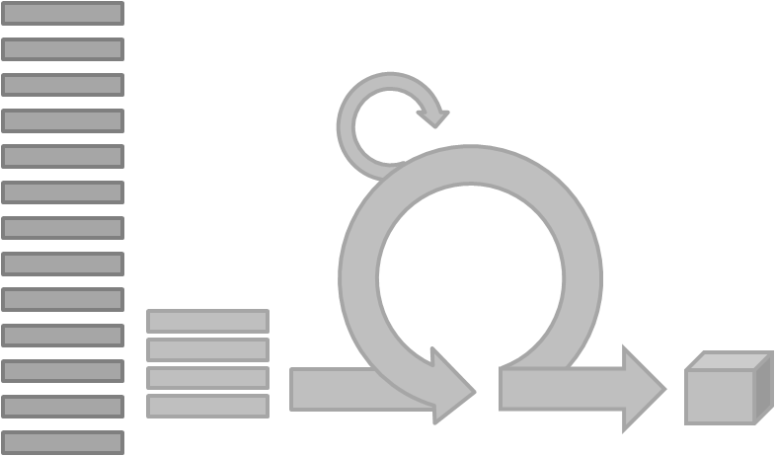
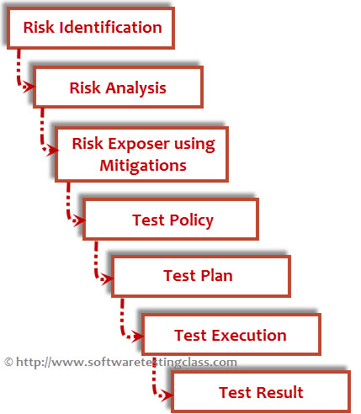
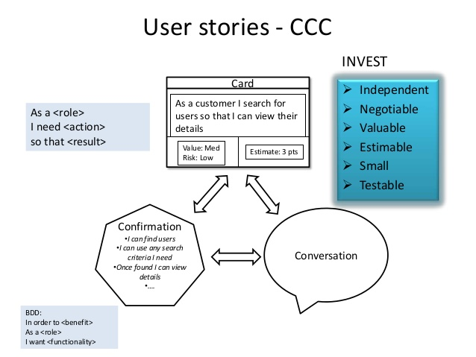
Risk Based Testing ⬄ Agile development

Slide 4
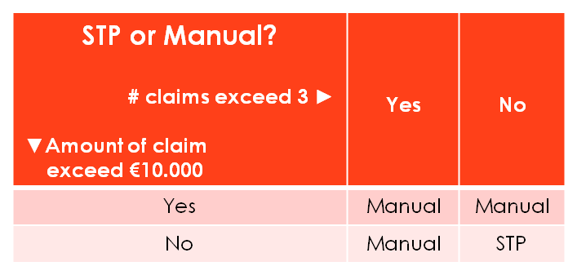
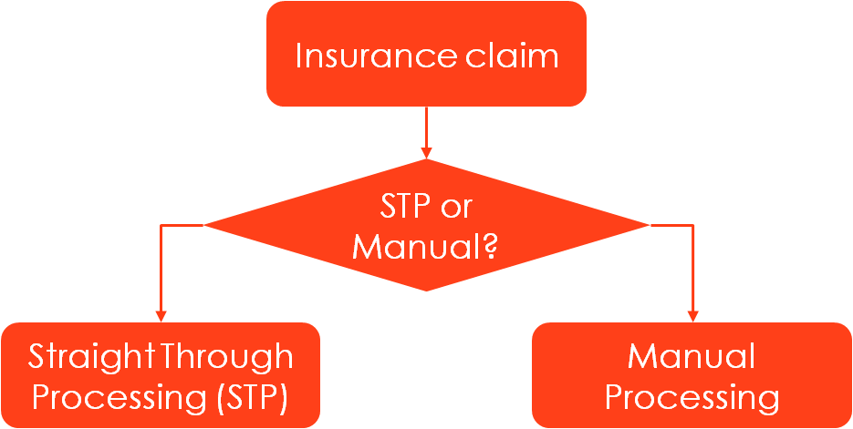
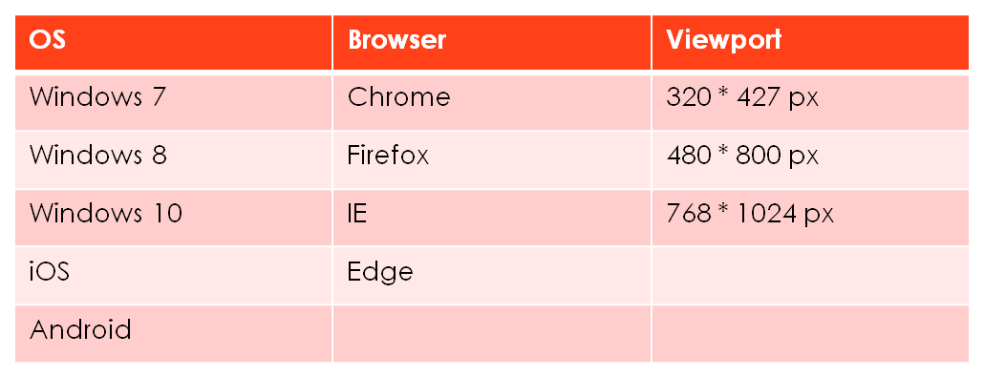
No risk, no test
Notes:
Let’s examine differentiating test coverage over an example:
My photo camera broke down on holiday. Fortunately I closed an insurance policy, so I filed a claim. Handling claims is highly automated, up to the point that for some claims no manual interference is needed, it’s handled completely automated, this is called Straight Through Processing or STP. After filing the claim (over the internet, obviously ;-), the insurance company workflow system decides what to do: take care of it (STP!) or put it on some claim officer’s to do list. This is the functional design ;-)
Testing the process flow? Test depth 1, 2, 3, etc. is the measure of test thoroughness.
Testing the business decision (decision table)? MCC, MCDC, DC etc. is the measure of test thoroughness
In the example to come we’ll apply data coverage: with ‘allvalues’, ‘allpairs’, ‘allTriplets’ (??), allCombination’s’ as measure of test thoroughness

Slide 5
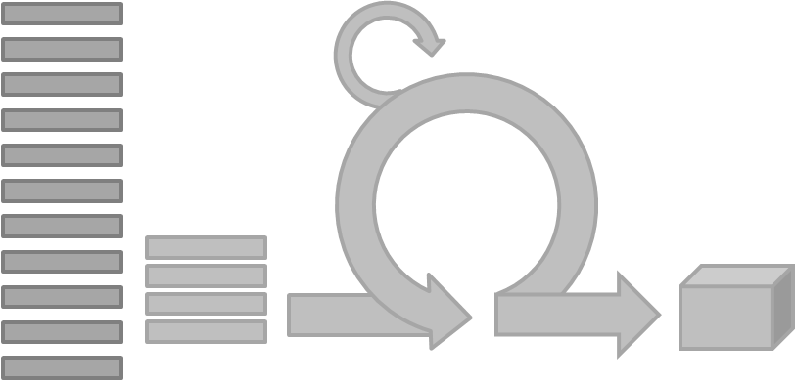
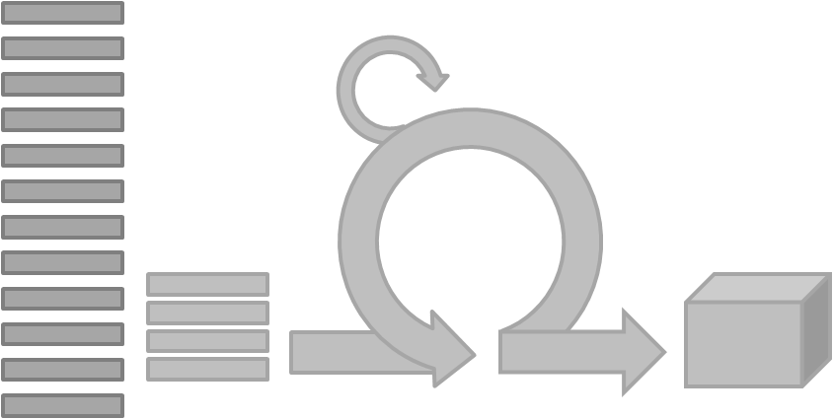
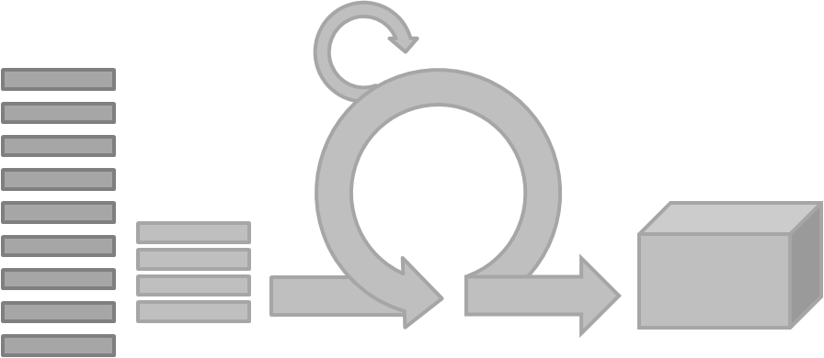
Risk Based Testing ⬄ Agile development
Regressing testing:
Testing existing
functionality
Progressing testing:
Testing new/updated
functionality

Slide 6
Developing a Premium Calculator
Sprint 1:
Traffic
Consumers and Home
Health and Family
Progression testing:
Explorary testing
Automation: data coverage
Sprint 2:
Added: Work and Income
Progression testing
Regression testing
Notes:
Sprint 1:
Manual testing (ET) and start with first version of automated regression test set
Data coverage, all combinations. (follow link to sprint1.data.json)
Sprint 2:
Manual testing (ET) and extend regression test set.
Challenge: how to reuse existing set of test cases …. ➔ use test case generation tool (follow link to datacombinations tool)
Next challenge: with replacement of old test set,we’ve lost the expected results … ➔ comparison based testing for regression
➔ So how do we create test cases for new and adjusted functionality?

Slide 7
Developing a Premium Calculator
Sprint 3:
Added: Pension and Social Security
Progression testing:
Explorary testing
Automated?
Regression testing
…
Sprint 4:
Added: Taxes and Assets
So, where is the risk based aspect …?
New functionality in sprint: all combinations
Regression test: all pairs
Cross browser testing
All values in daily build
All combinations every weekend
Notes:
Sprint 3:
Repetition of sprint 2!

Slide 8
Cost Requirements For Insurances
Insurance | Family Single |  | Family Married
 | Without kids | With Kids | Without kids | With Kids
Traffic | € 4,42 | € 4,60 | € 4,60 | € 4,60
Consumers & home | € 7,21 | € 7,51 | € 7,51 | € 7,51
Health & family | € 1,68 | € 1,68 | € 4,71 | € 4,71
Work & income | € 7,79 | € 8,12 | € 8,12 | € 8,12
Pension and Social Security | € 0,44 | € 0,46 | € 0,46 | € 0,46

Slide 9
Test Data Generation
Some Challenges with Test Data
Changes in requirements
Updates needed in automated test data
Less test coverage due to insufficient test data
Need for test data in formats like JSON, CSV
8 conditions to test = 2⁸ = 256 possible test cases

Slide 10
Solution for every challenge
Challenge | Mitigation with tooling and methodologies
Generation of test data | Test data provisioned by tooling based on test conditions
Less test coverage due to insufficient test data | Tooling enables generating of required combinations of test data (All pairs, All values & All combinations)
Changes in requirements | Tooling enables regeneration of test cases easily
Updates needed in automated test data | Tooling enable regeneration of input test data
Need for test data in formats like JSON, CSV | Tooling enables regeneration of test data in required format i.e JSON, CSV etc.

Slide 11
Tools used for test data generation
Data Combinations for generating the different input combinations based on the conditions.
Input combinations based on All values
Input combinations based on All Pairs
Input combinations based on All combinations
Excel for determining the expected outcome for the different input combinations

Slide 12


Slide 13
Summary
Not everything needs to be tested in the CICD pipeline.
Don’t maintain individual test cases, maintain the test model and generate the test cases.
Don’t maintain expected results for your regression test set, get them from production.
Notes:
Advantage: Generate test cases on the fly
Kanttekening: weet wel wat je test: data integriteit kan je niet testen met comparison based testing!

Slide 14
Thank you!

Slide 16

No risk, no test
Insurance claim
STP or Manual? # claims exceed 3 ► ▼Amount of claim exceed €10.000 | Yes | No
Yes | Manual | Manual
No | Manual | STP
STP or Manual?
Straight Through Processing (STP)
Manual Processing
Notes:
Let’s examine differentiating test coverage over an example:
My photo camera broke down on holiday. Fortunately I closed an insurance policy, so I filed a claim. Handling claims is highly automated, up to the point that for some claims no manual interference is needed, it’s handled completely automated, this is called Straight Through Processing or STP. After filing the claim (over the internet, obviously ;-), the insurance company workflow system decides what to do: take care of it (STP!) or put it on some claim officer’s to do list. This is the functional design ;-)
Testing the process flow? Test depth 1, 2, 3, etc. is the measure of test thoroughness.
Testing the business decision (decision table)? MCC, MCDC, DC etc. is the measure of test thoroughness
In the example to come we’ll apply data coverage: with ‘allvalues’, ‘allpairs’, ‘allTriplets’ (??), allCombination’s’ as measure of test thoroughness

Slide 17
OS | Browser | Viewport
Windows 7 | Chrome | 320 * 427 px
Windows 8 | Firefox | 480 * 800 px
Windows 10 | IE | 768 * 1024 px
iOS | Edge
Android

